Slide 1
PC Maintenance: Preparing for A+ Certification
Chapter 16: Monitors

Slide 2
Chapter 16 Objectives
Identify types of monitors
Explain how CRTs and LCDs work
Describe measurements of monitor quality
Configure multiple monitors in Windows
Adjust refresh rate in Windows
Adjust a monitor using its onscreen controls

Slide 3
Types of Monitors
CRT
  Shadow Mask
  Aperture Grille
  Slot Mask
LCD
  Passive Matrix
  Active Matrix
  TFT

Slide 4
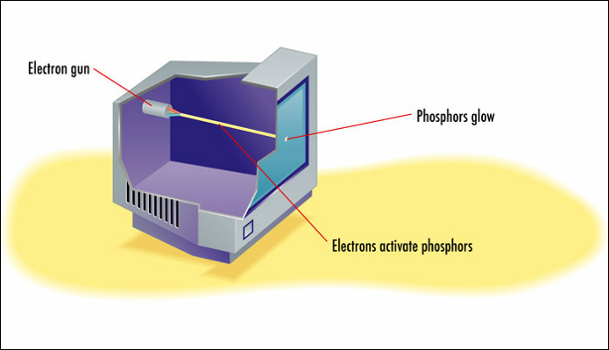
How CRTs Work
Electron gun makes phosphors glow
Phosphors must be continually refreshed

Slide 5
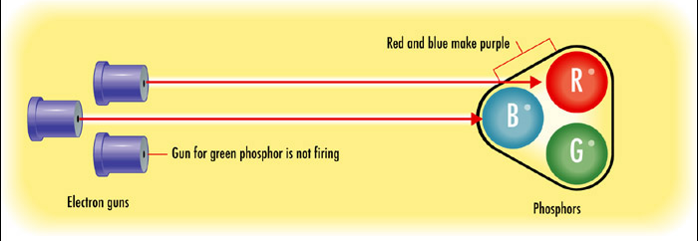
Triads
A set of red, green, and blue dots
Separate electron guns for each color

Slide 6
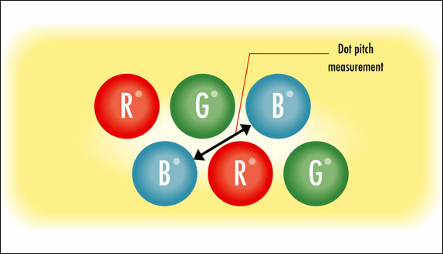
Dot Pitch
Measurement of monitor quality
Distance between two phosphors of the same color in adjacent triads

Slide 7
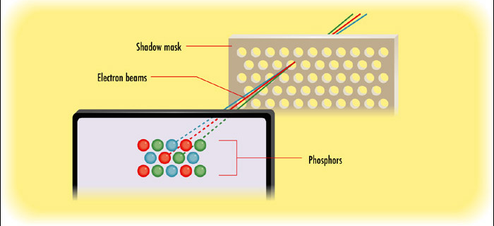
Shadow Mask
Screen that keeps the electron beams aligned to focus on the correct phosphors

Slide 8
Liquid Crystal Diode (LCD)
Two polarized filters with liquid crystal between them
Light must pass through all three items to make it to the display

Slide 9
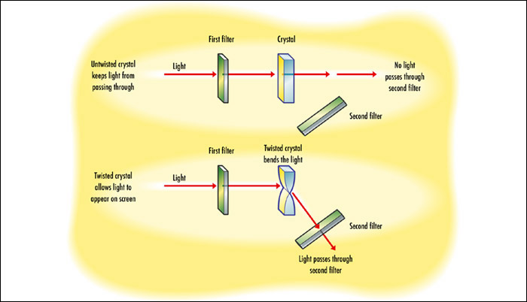
How LCDs Work
One filter is at an angle so by default light cannot pass through it

Slide 10
How LCDs Work
When electricity is applied to the crystal, it twists
Light refracts through twisted crystal and passes through second filter

Slide 11
Color LCD
Additional filter splits the light into separate cells for red, green, and blue
No need for a mask (no electrons)

Slide 12
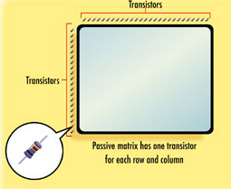
Passive Matrix
One transistor for each row and each column in the display

Slide 13
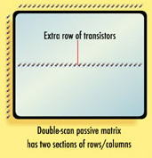
Double-Scan Passive Matrix
Extra row of transistors

Slide 14
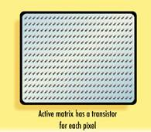
Active Matrix
One transistor for each pixel at the maximum resolution

Slide 15
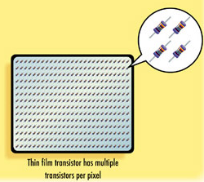
Thin Film Transistor (TFT)
Multiple transistors per pixel
Found on all modern LCD screens

Slide 16
Measurements of Monitor Quality
Maximum Resolution
Dot Pitch
Viewable Image Size
Maximum Refresh Rate (at a certain resolution)
Adjustment capabilities
Interface (VGA, DV-I, BNC)

Slide 17
Connecting Multiple Monitors
Two video cards, or single card with multiple outputs
Windows should recognize both video cards
Display Properties show the multiple monitors in Windows

Slide 18
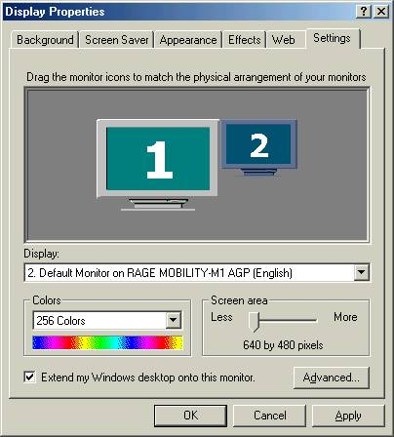
Configuring Multiple Monitors in Windows
Choose to extend desktop onto secondary monitor if desired
Otherwise both monitors will show same image

Slide 19
Installing a Monitor Driver
Not really a driver: INF file only
Tells Windows maximum refresh rate and resolution of monitor
Install from Device Manager or with Add/Remove Hardware Wizard

Slide 20
Refresh Rate
Important to have monitor correctly identified in Windows first
  Too-high setting can damage monitor
  Windows hides resolutions not supported by monitor (as identified)
Use Optimal setting if available
If not, use any setting 85hz or above
Higher setting means less flicker

Slide 21
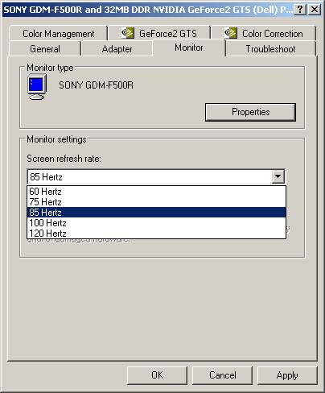
Set the Refresh Rate
From Display Properties, find screen refresh rate setting for monitor
Windows 2000/XP: Settings tab, Advanced button, Monitor tab

Slide 22
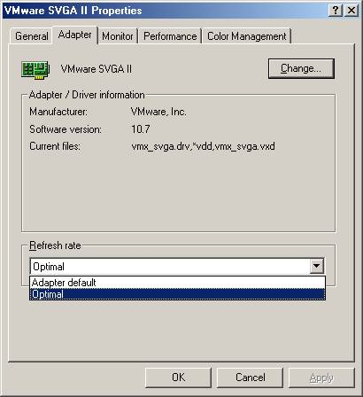
Set the Refresh Rate
Windows 9x/Me: Settings tab, Advanced button, Adapter tab

Slide 23
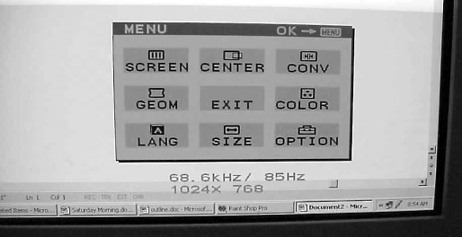
Adjusting a Monitor
On-screen controls provided in monitor itself
No relationship to PC or operating system

Slide 24
Adjusting a Monitor
Brightness: light in the display
Contrast: difference between light and dark
Geometry: tilt and shape of picture onscreen
Size: overall taller or shorter, wider or narrower
Centering: picture’s position within monitor
Convergence: relationship of red, green, blue phosphors in the triads to one another
Color: overall tint and saturation of picture

Slide 25
Servicing a CRT Monitor
Not usually done by regular PC technicians
Risk of electrocution, 30,000 volts
High-voltage capacitor retains charge for many months after unplugged
Before working on a monitor, technician must discharge the capacitor

